Slide 1

“SMART & PORTABLE THERMOELECTRIC HEATING/COOLING DERIVED FOODWARE”
Submitted By
ASEEM SAXENA

Slide 2
CONTENTS
INTRODUCTION
LITERATURE REVIEW
PRODUCT DESIGN & SPECIFICATION
MATHEMATICAL FORMULATION
ADVANTAGES
DISADVANTAGES
APPLICATION
References

Slide 3
E2O : A Smart & Portable Thermoelectric Heating/Cooling Derived Foodware
INTRODUCTION
World demand for food containers is forecast to rise 4.5 percent annually to $139 billion in 2017. While the US remains by far the world’s largest user of food containers, the most significant growth will occur in India and China.
We’ve come across the idea of building a small, lightweight and portable product offering real time food temperature modulation just before consumption which also helps in decreasing heat losses of hot food after cooking and prevents food spoilage.
India's First Smart Temperature-Adjustable Foodware. There have been a lot of advancements made to cups over the years, but no one's made anything for the "modern man," until the E2O : Smart & Portable Thermoelectric Heating/Cooling Derived Foodware.

Slide 4
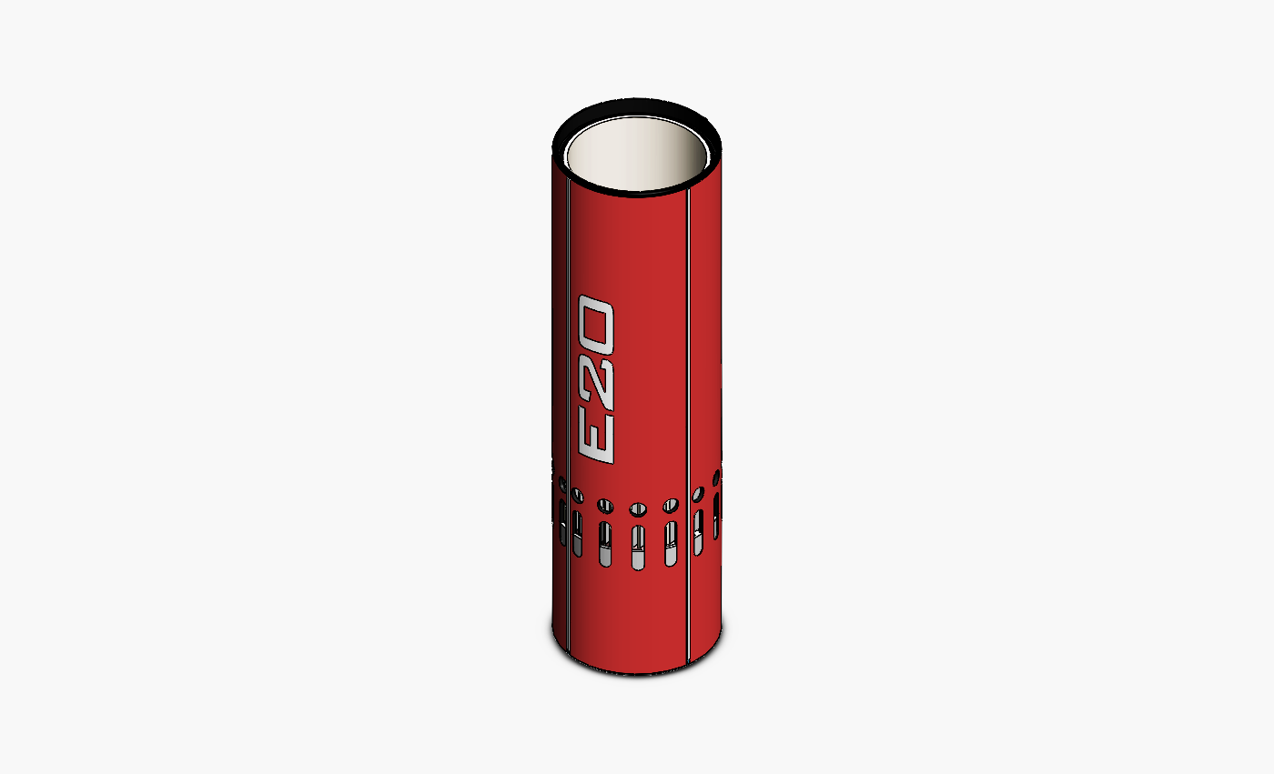
You can take the E2O with you absolutely anywhere you go either its Office, gym, college or park! With the smart Foodware, your cold beverages can stay cold, and you can heat up your warm beverages on the go.
The smart foodware itself can be charged, using a C-type USB, or using an Wireless charging port for fast charge. The cup is controlled by a mobile App, And provide functionalities like cool down and heating of your beverage on the go, It also sends notifications as soon as your drink is ready.
Provides best suitable fluid temperature according to the surroundings for shear human comfort

Slide 5
LITERATURE REVIEW On Technology
The theories behind the operation of thermoelectric cooling first appeared in the early 1800s.
Jean Peltier discovered a heating/cooling effect when passing electric current through the junction of two conductors.
Alessandro Volta and Thomas Seebeck found that holding the junctions of two dissimilar conductors at different temperatures creates an electromotive force or voltage.
William Thomson (Lord Kelvin) showed that over a temperature gradient, a single conductor with current flowing in it has reversible heating and cooling.

Slide 6
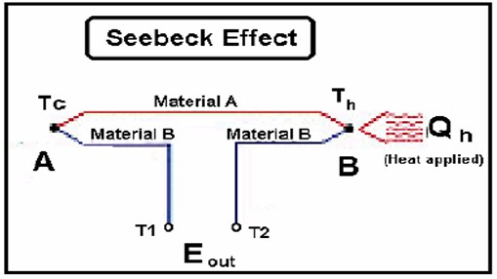
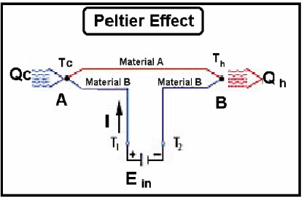
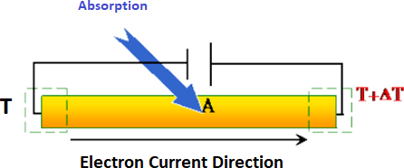
Theory
Thermoelectric effect
The Peltier effect
The Thomson effect

Slide 7
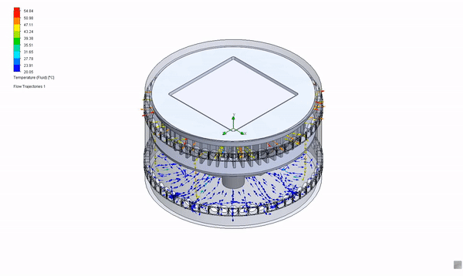
PRODUCT DESIGN & SPECIFICATION

Slide 8
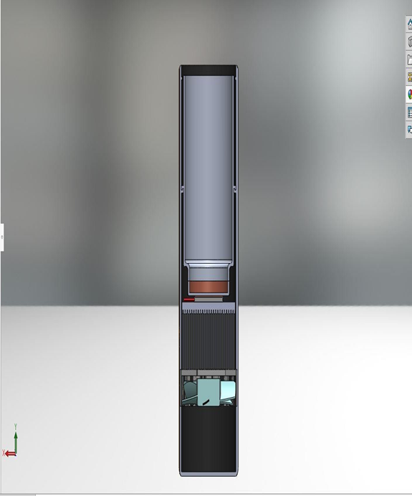

Slide 9
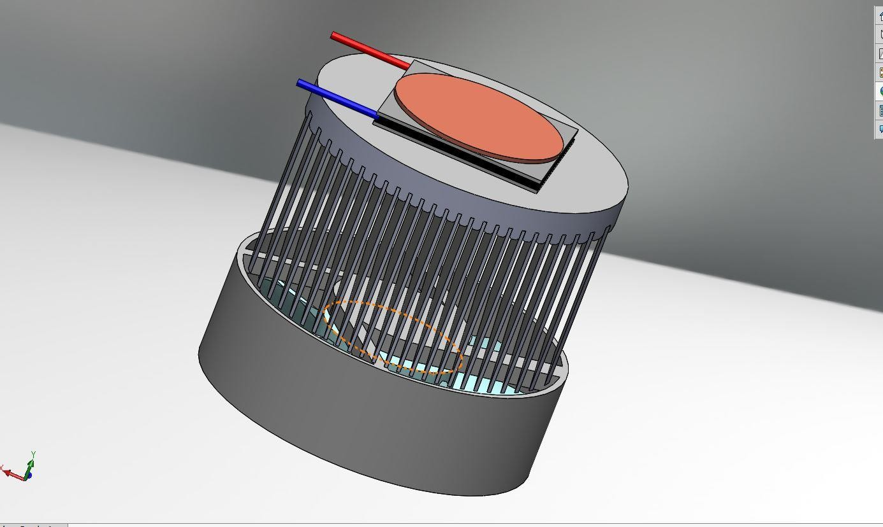
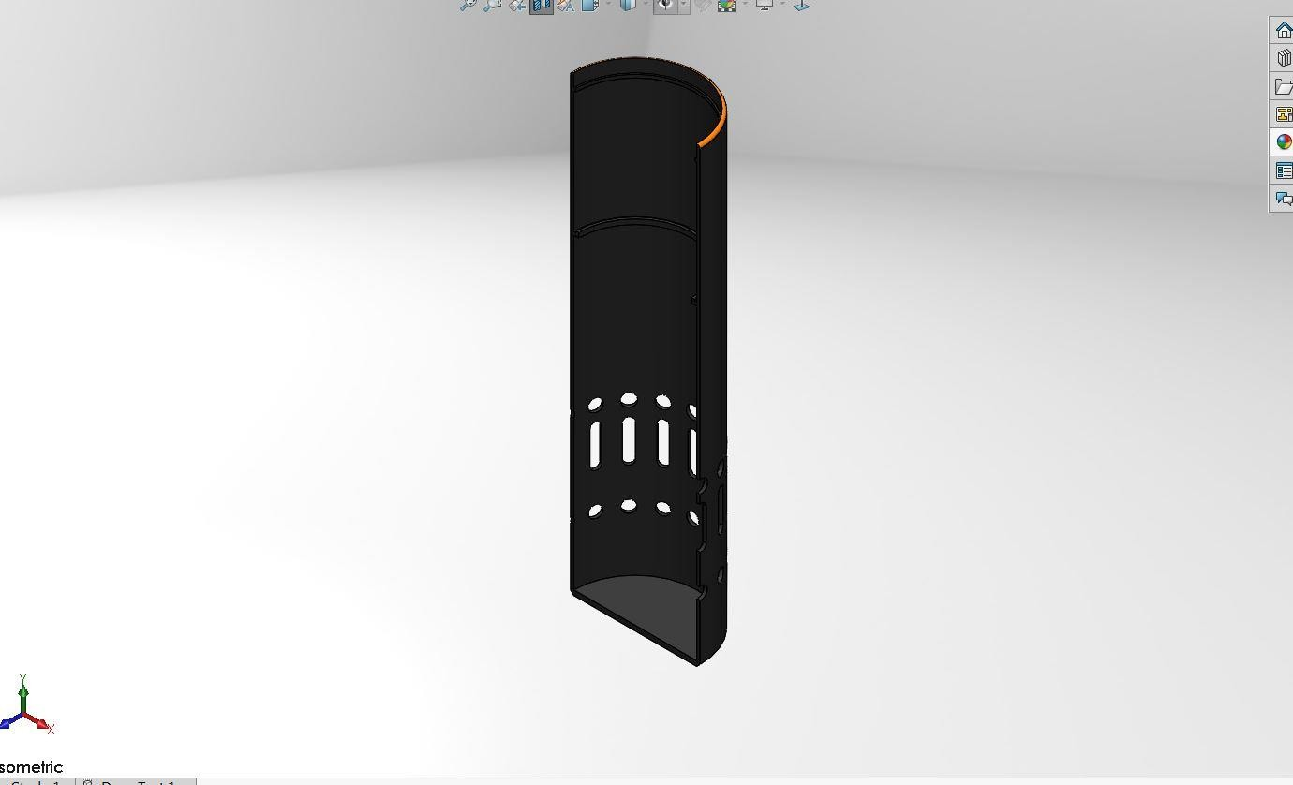
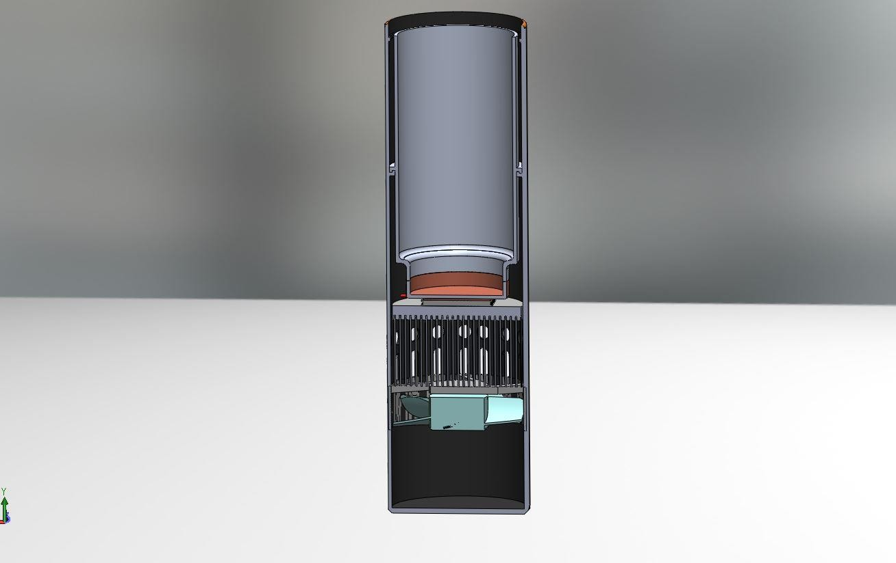
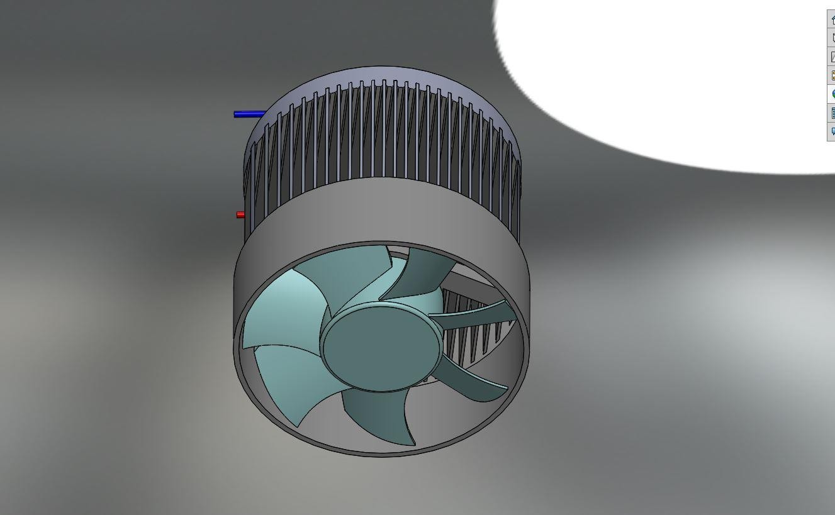

Slide 10
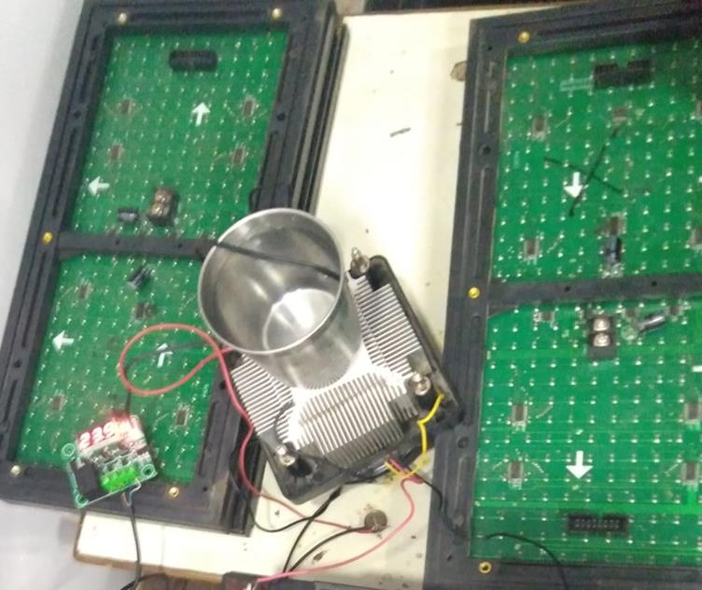
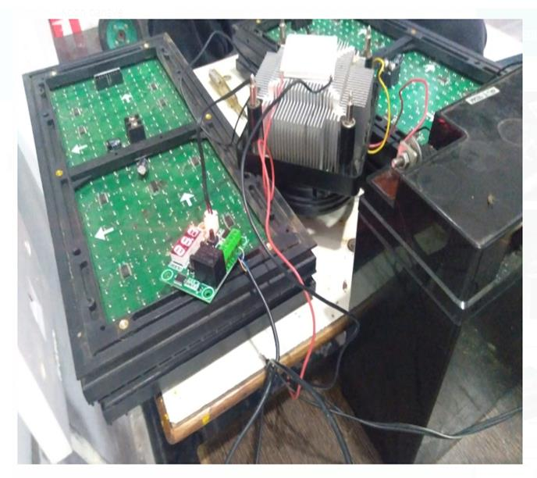
EXPERIMENTAL SETUP

Slide 11
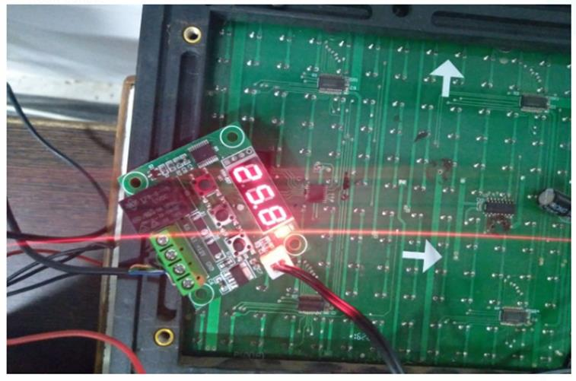
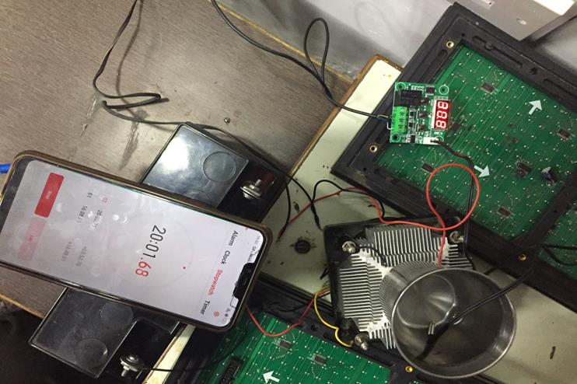

Slide 12
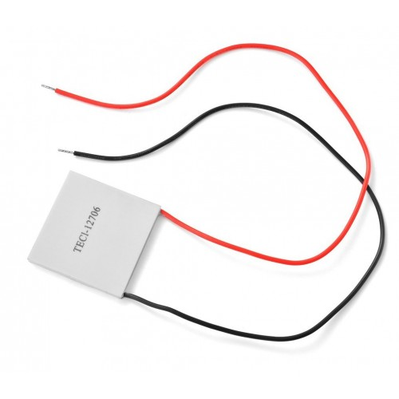
SPECIFICATONS
Peltier Model TEC1-12706
Operating Voltage(VDC) 12
Maximum Voltage(V) 15
Maximum Current(A) 6.4
Maximum Power (W) 114
Internal Resistance(Ω) 1.98
Wire Length(mm) 200
Length (mm) 80
Width (mm) 80
Height (mm) 280
Weight(gm) 30
Shipment Weight 1.05 kg

Slide 13
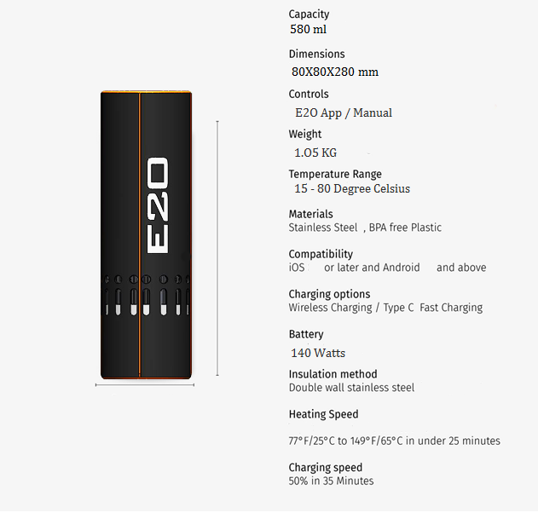

Slide 14
MATHEMATICAL FORMULATION
COP = Q_{C} / P_{el}
COP or Coefficient of Performance for Peltier Modules is :
Minimal total heat is dissipated by the heat sink.
(Q_{h} = Q_{C} + P_{el)}

Slide 15

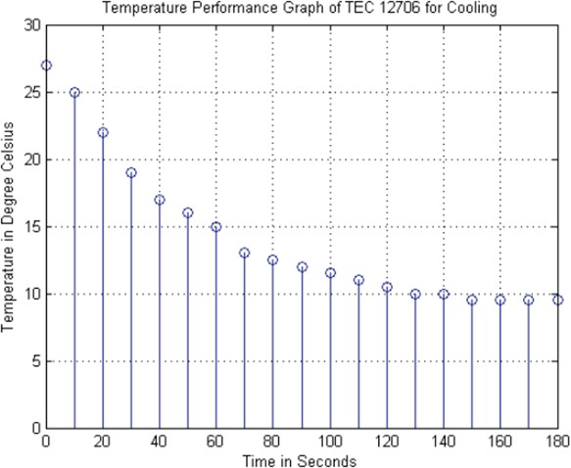
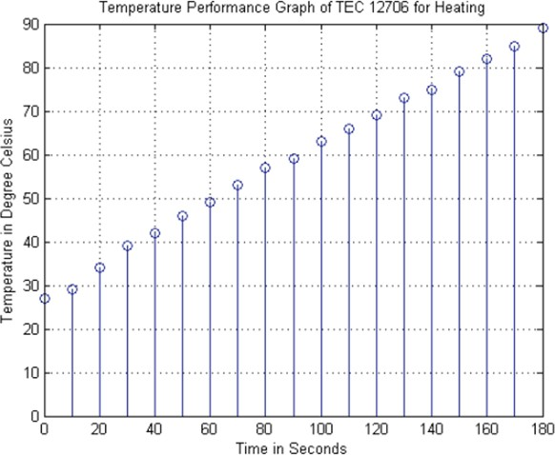

Slide 16
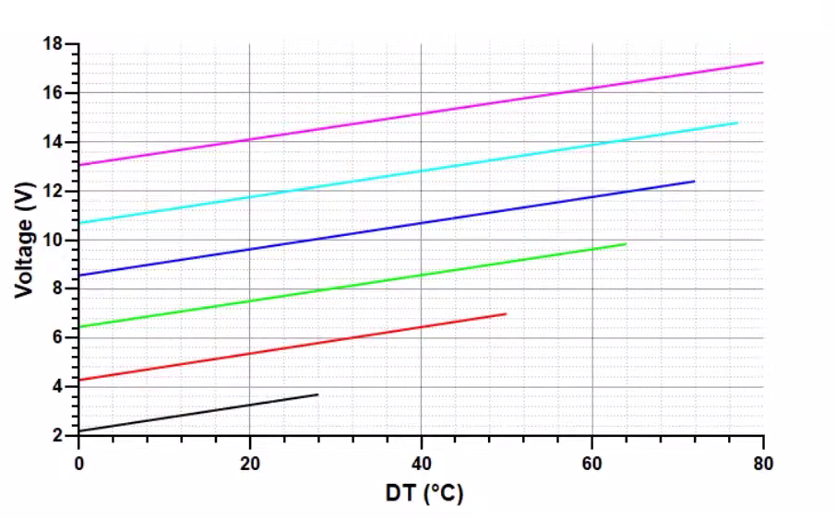
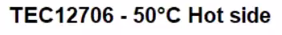
CHARTS

Slide 17
Thermal resistance is calculated by:
R_{thHS} = ΔT_{HS} / Q_{h} [K/W]
Where: ΔT_{HS} = Temperature difference between the heat sink and the ambient air temperature [K]
Q_{h} = Total heat load (object + Peltier element loss) [W]
To estimate ΔT_{HS} we have to consider the maximum possible ambient temperature.

Slide 18
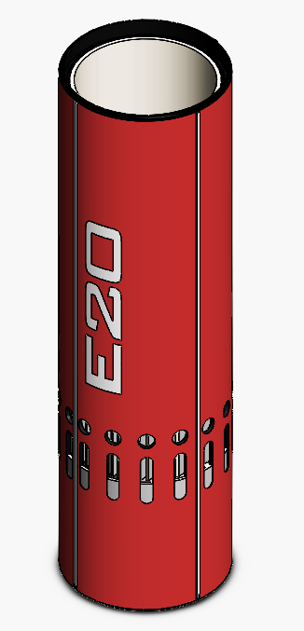
MODELS
STANDARD
CHERRY RED

Slide 19
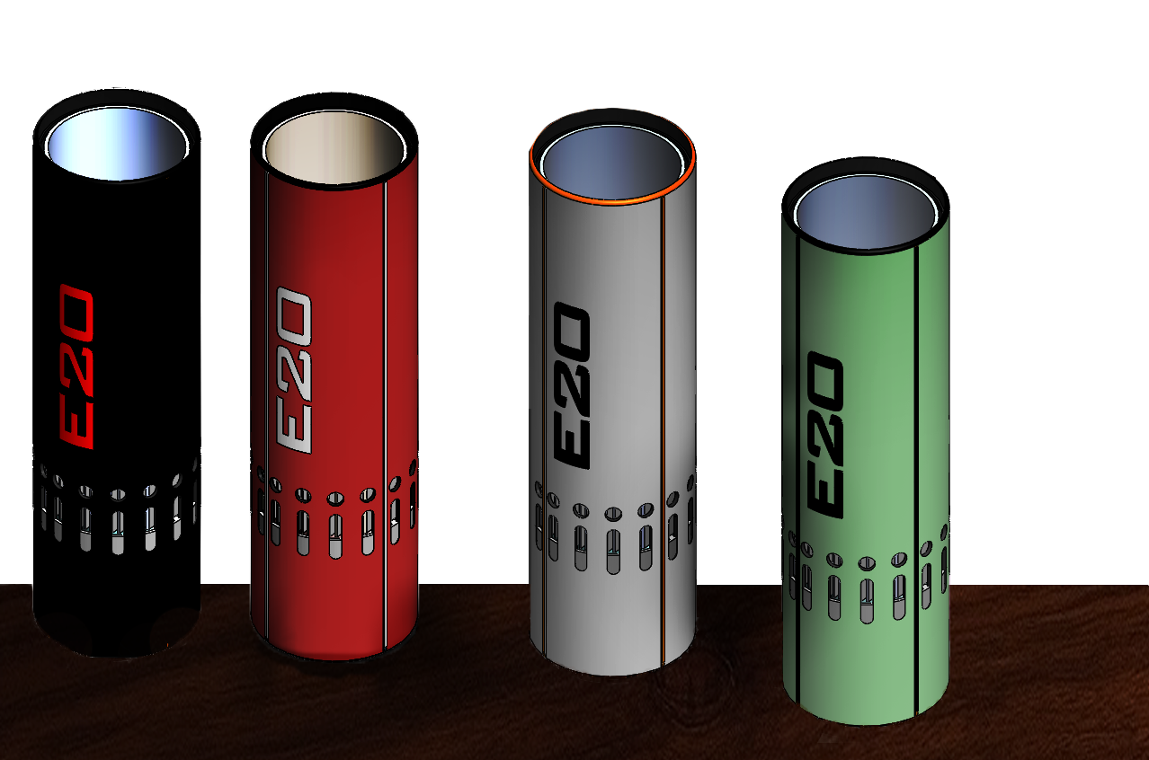
JEDI BLACK
CHERRY RED
NARDO GREY
TEA GREEN

Slide 20
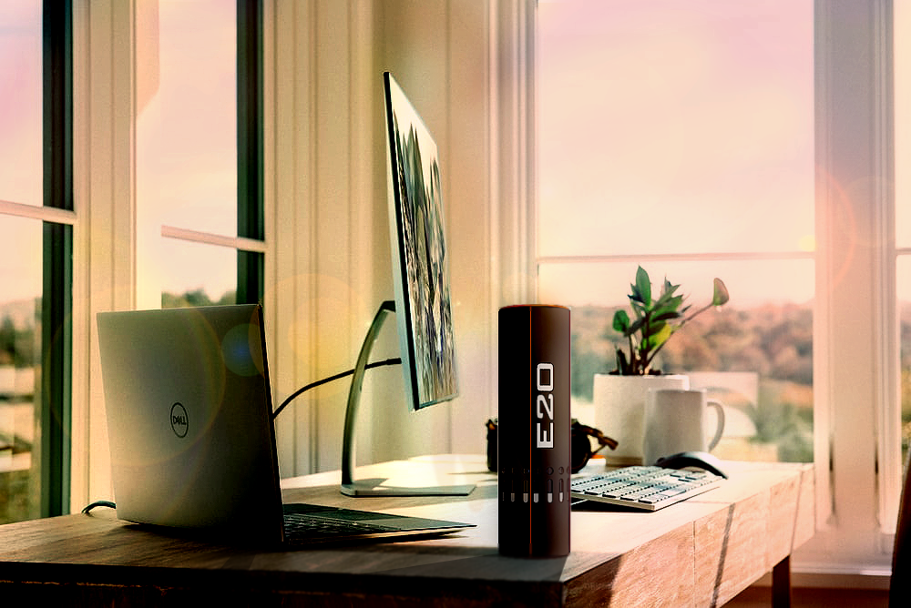
FINAL RENDER

Slide 21
COST ANALYSIS
SN. | NAME OF MATERIAL/EQUIPMENT | COST (INR)
1 | TEC-12706 (Peltier), 60W | 400 -/
2 | Heat Sink (Fan Incorporated) | 350 -/
3 | IOT Unit | 750 -/
4 | Equipment Housing | 850 -/
5 | Li-ion Rechargeable Battery Pack | 600-/
6 | Aluminium Flask | 250 -/
7 | Thermal paste | 100-/
8 | TEC Controller unit (with thermostat) | 500 -/
9 | TOTAL Estimated cost | 3800 -/(approx.)

Slide 22
ADVANTAGES
Internal heat generation and manipulation achieves the desired results without using bulky refrigeration system and high power consuming induction coils.
App controlled IOT infrastructure enables to monitor and control over various settings of the product.
Provides preferred food/drug temperature to the user at anytime and anywhere unlike the conventional storage which relies on thermal insulation.
Accessibility and portability enables to carry it anywhere on the go.

Slide 23
DISADVANTAGES
Using Peltier module limits the size of the product and as the size increases so
the inefficiencies of the module.
The temperature maintained by the product only varies from 10°C To 80°C

Slide 24
APPLICATION
This product will monopolise and dominate the market due to its distinctive technology to acquire temperature modulation in storage container(Tiffin, Bottles, Electric Tiffin using induction coils)
The modern alternative for the portable food/drug storage utensils.
The internal heat generation and manipulation enables it use any time without much heat loss to the environment.

Slide 25
References
Kaseb S., El-hairy G, Electronics Cooling, Mechanical Power Engineering Department, Faculty of Engineering, Cairo University, Egypt.
H. Julian Goldsmid, Bismuth Telluride and Its Alloys as Materials for Thermoelectric Generation, Materials 2014, 7, 2577-2592.
S. Riffat, S.A. Omer, Xiaoli Ma, A novel thermoelectric refrigeration system employing heat pipes and a phase change, Renewable Energy 23 (2001) 313–323.
R. Chain, Y. Chen, “Performances of thermoelectric cooler integrated with micro channel heat sinks”, International Journal of Refrigeration 28 (2005) 828–839.
S. Riffat, X. ma, Improving the coefficient of performance of thermoelectric cooling systems, international journal of energy research Int. J. Energy Res. 2004; 28:753–768.
J. Vian, D. Astrain, “Development of a heat exchanger for the cold side of a thermoelectric module”, Applied Thermal Engineering 28 (2008) 1514–1521.

Slide 26
THANKS!
Any questions?

